Slide 1
The National FAA Safety Team Presents
Tips for Winter Flight Operations
<Audience>
<Presenter>
< >
Notes:
2024/09-10-316(I)PP Original Author: J. Steuernagle POC Kevin Clover AFG-930 Program Manager, Ops. Office (562-888-2020)
This is the title slide for Winter Operations – Flying and Surviving in Winter Weather
Script - We have included a script of suggested dialog with most slides. The script will always appear in a non-italic font. Presenters may read the script or modify it to suit their own presentation style. See template slides 5 and 6 for examples of a slides with script.
Presentation Instructions - (stage direction and presentation suggestions) will be preceded by a Bold header: the instructions themselves will be in Italic fonts. See slides 2, 3, and 4 for examples of slides with Presentation Instructions only.
Program control instructions - will be in bold fonts and look like this: (Click) for building information within a slide; or this: (Next Slide) for slide advance.
Background information - Some slides may contain background information that supports the concepts presented in the program.
Background information will always appear last and will be preceded by a bold Background: identification.
The production team hope you and your audience will enjoy the show. Break a leg!
(Next Slide)

Slide 2
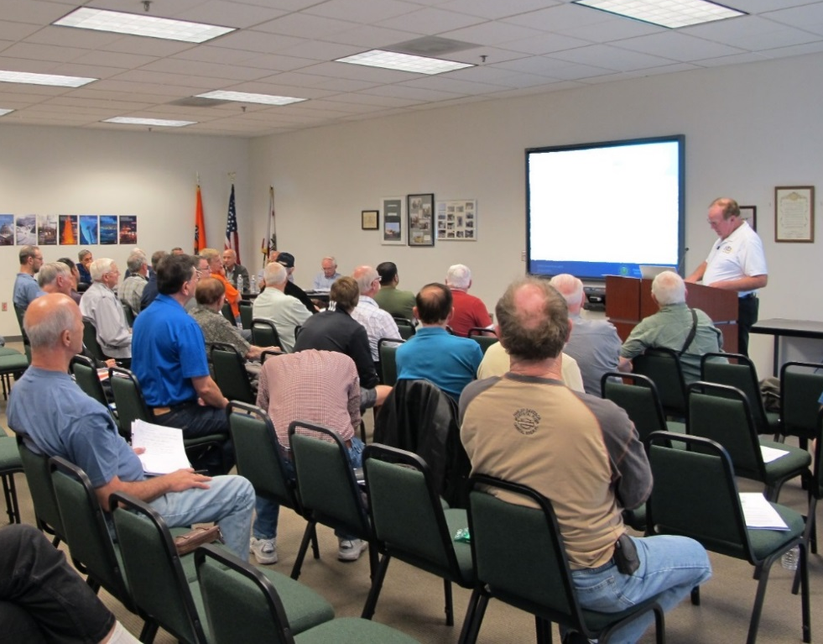
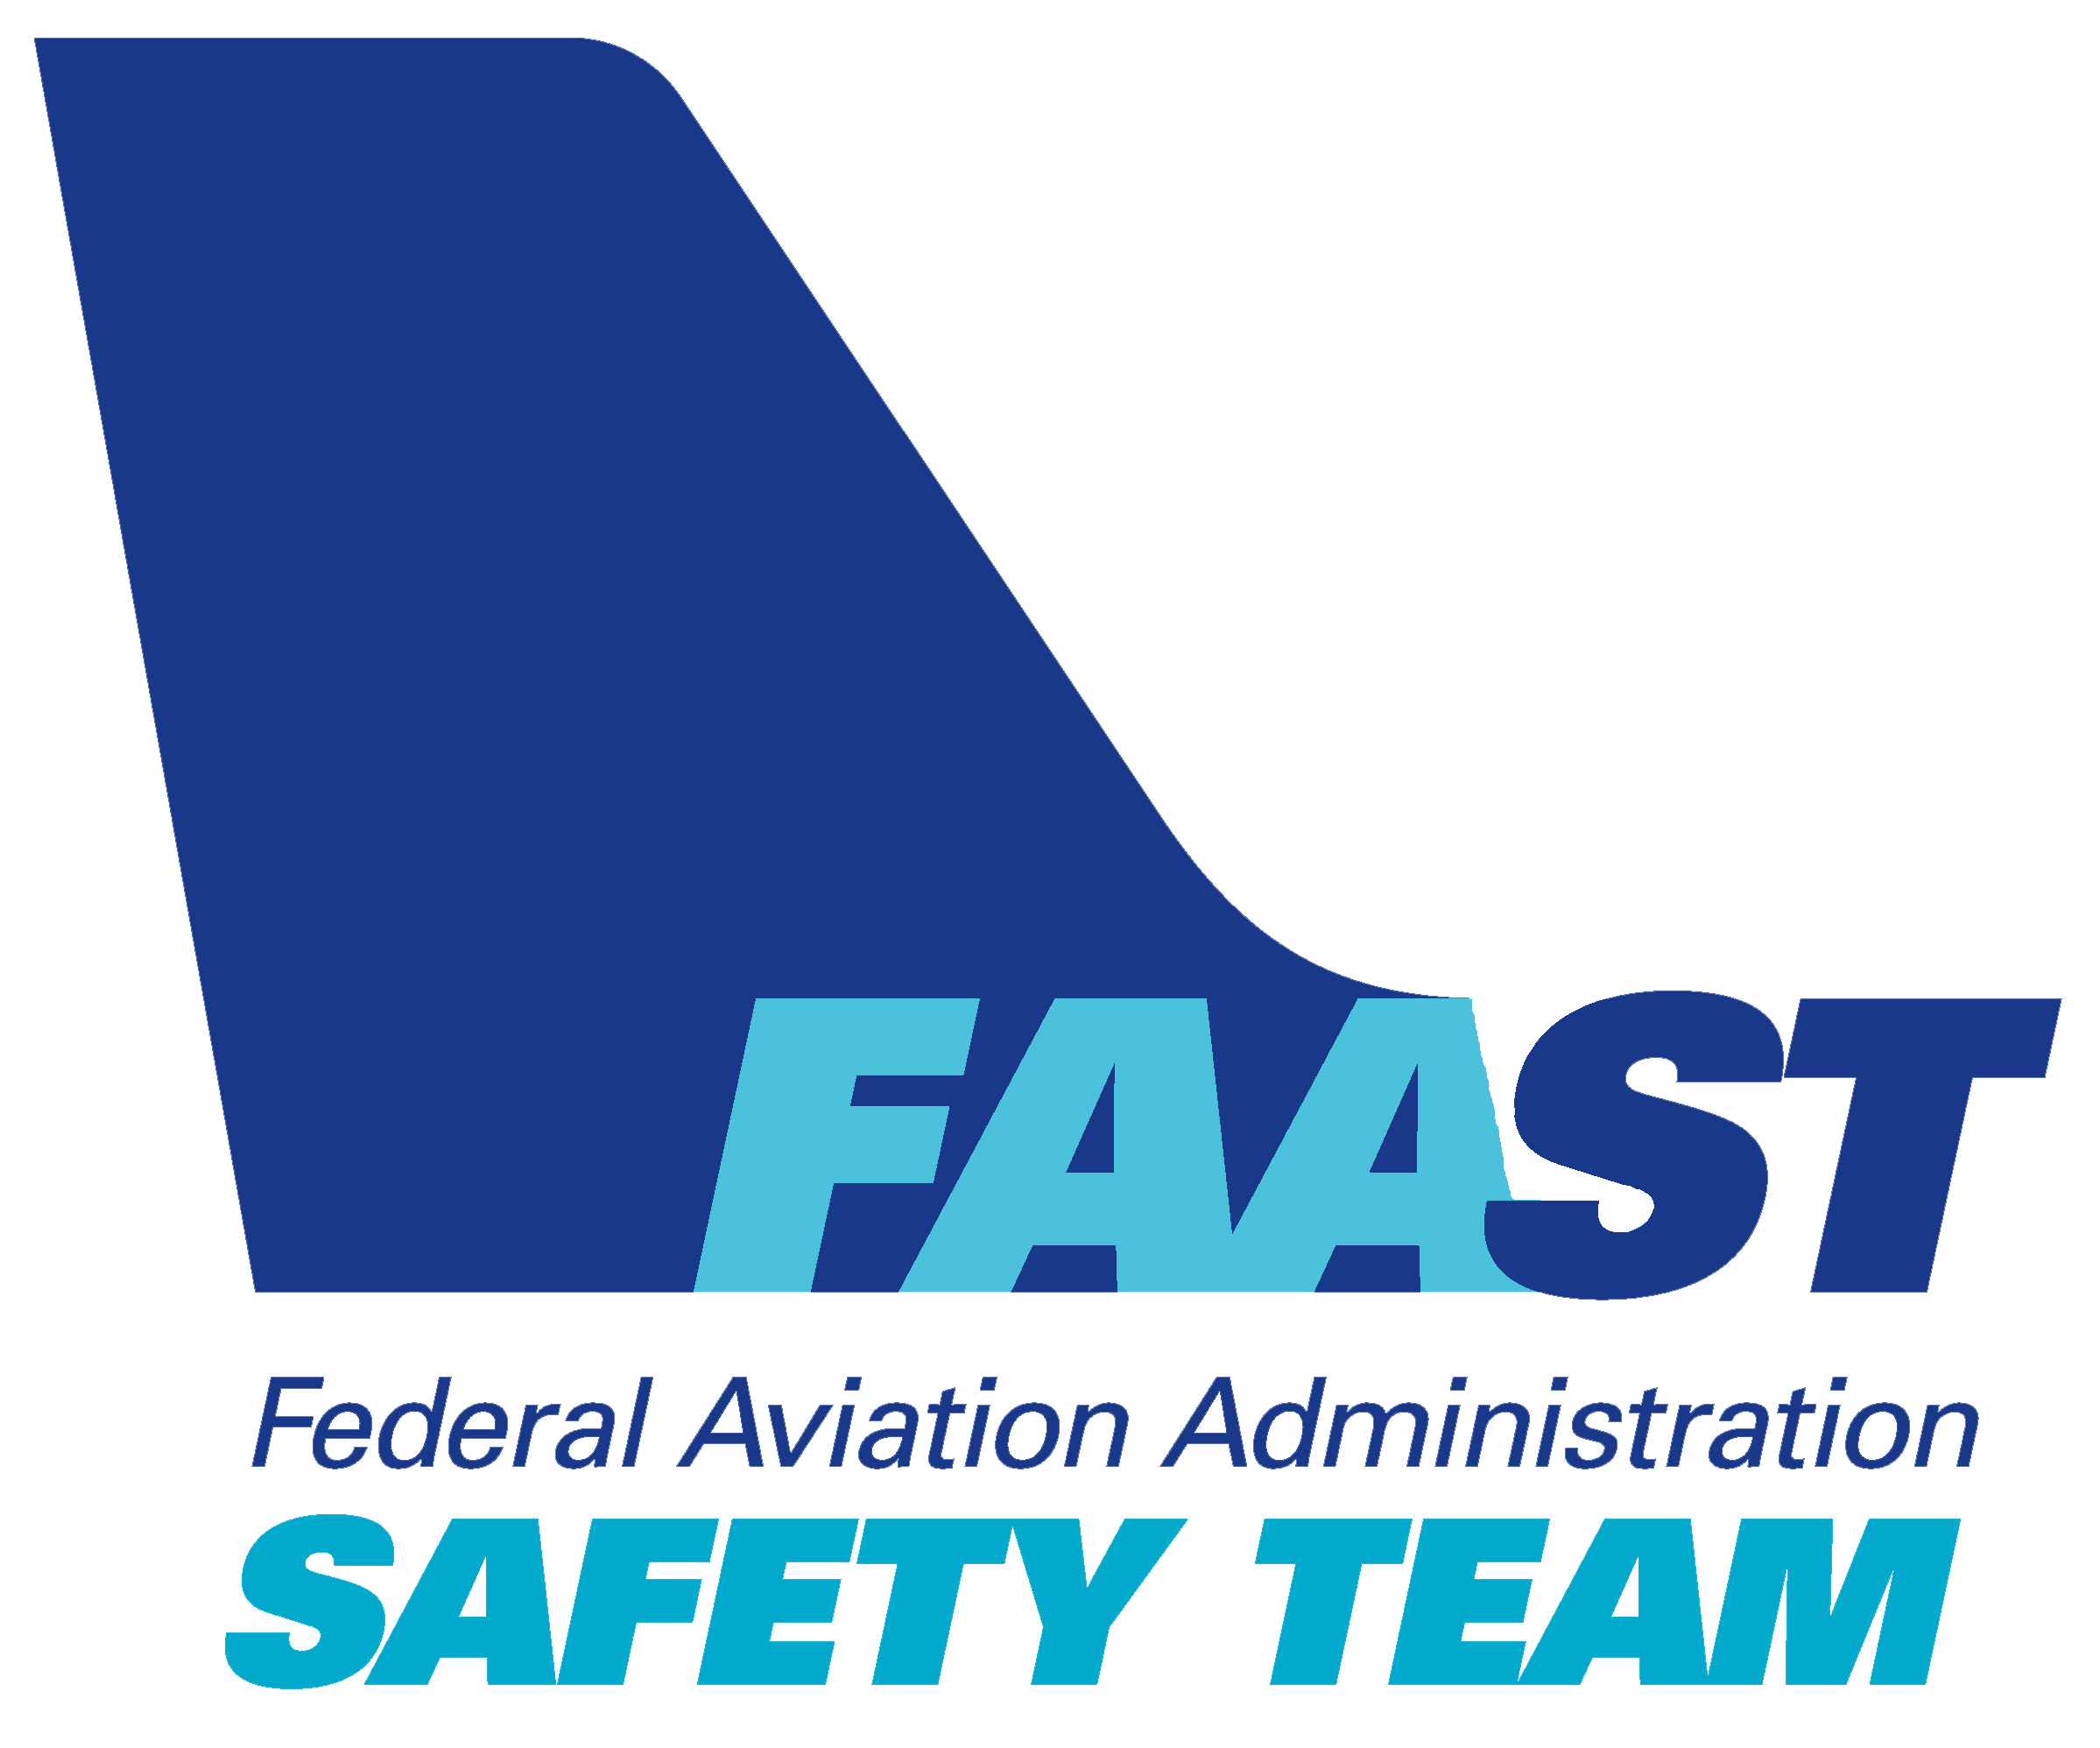
Welcome
Exits
Restrooms
Emergency Evacuation
Breaks
Sponsor Acknowledgment
Set phones & devices to silent or off
Other information
Notes:
Presentation Note: Here’s where you can discuss venue logistics, acknowledge sponsors, and deliver other information you want your audience to know in the beginning.
You can add slides after this one to fit your situation. (Next Slide)

Slide 3
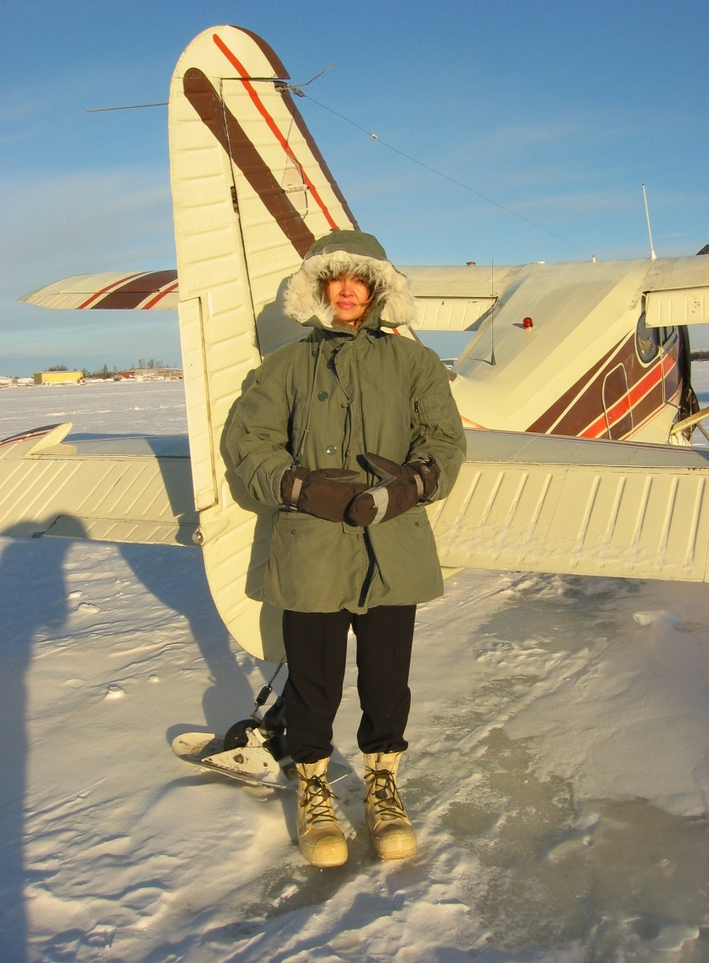

Everything takes longer
Dress for Success
Notes:
It seems like everything takes longer in winter. Just getting ready to leave the house involves dressing for the operational environment. Walking a couple of blocks in the city (Click)
is considerably easier than making your way in the boonies. Either way it pays to dress for success. That means wearing protective clothing.
(Next Slide)

Slide 4
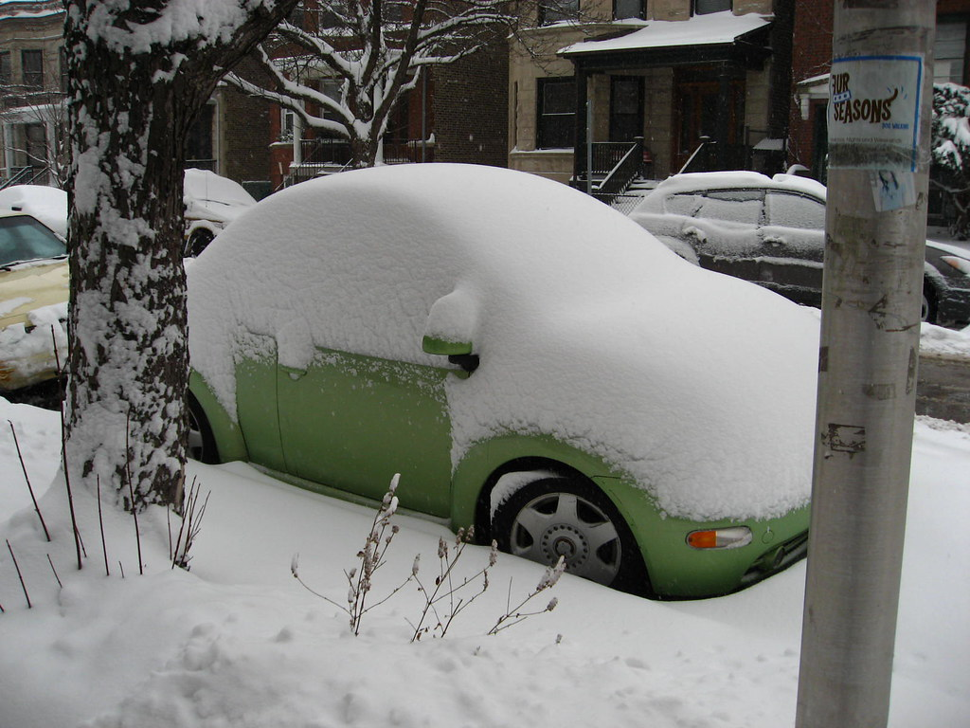
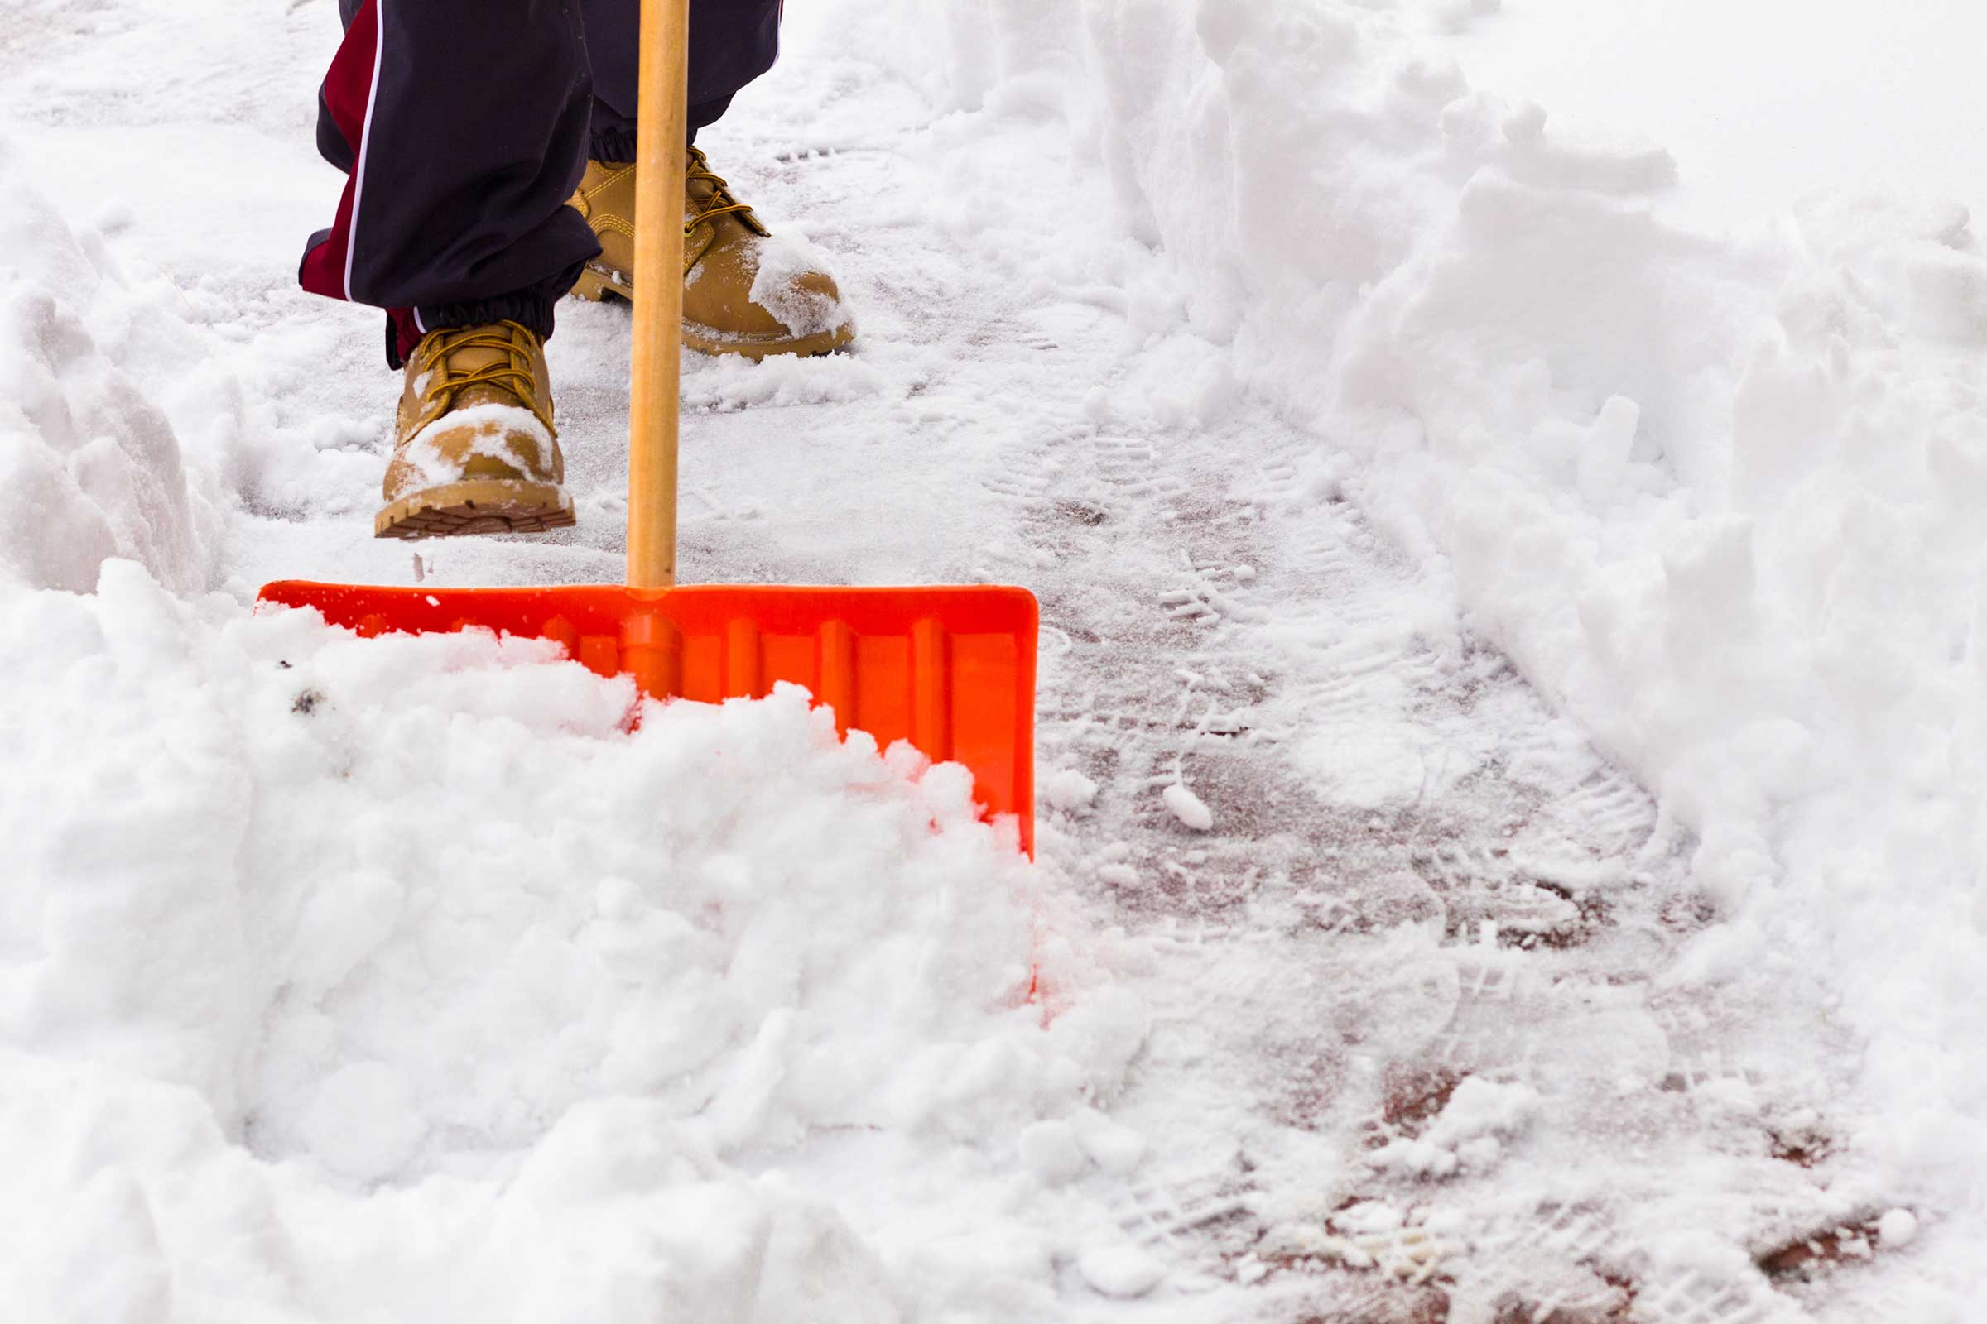
Everything takes longer
Dressing for Success
Clearing a path
This Photo by Unknown Author is licensed under CC BY-NC-ND
Notes:
Leaving the house may involve clearing a path to the car. If you do have to shovel, you’ll also have to clean snow and ice from the car before you start for the airport.
(Next Slide)

Slide 5
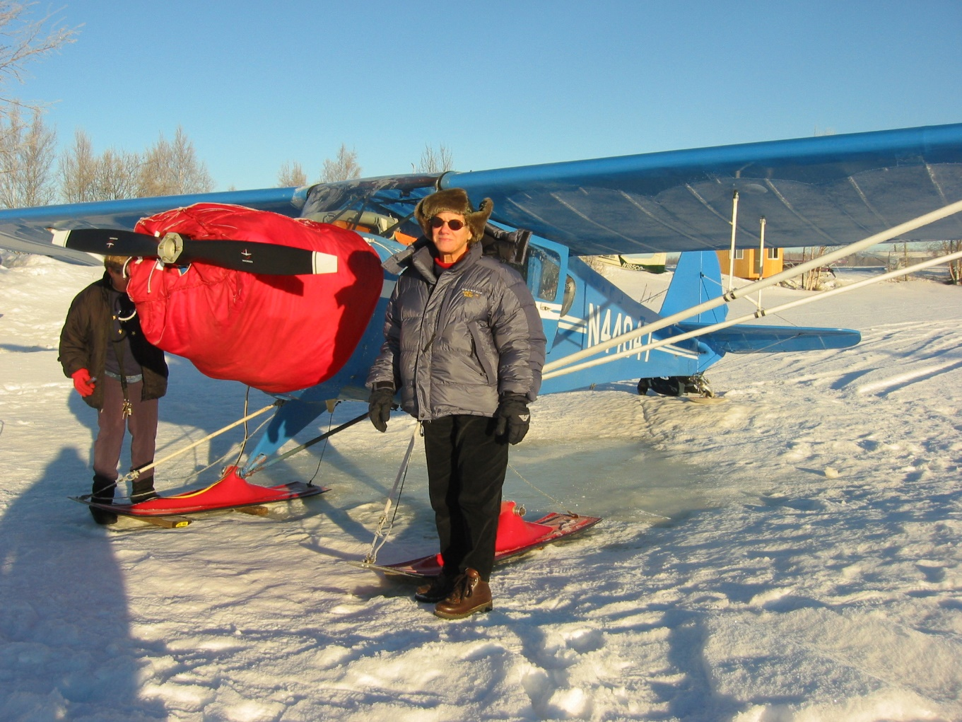


Everything takes longer
This Photo by Unknown Author is licensed under CC BY
Notes:
That trip to the airport can take much longer in winter so add some extra time in your schedule for the commute. (Click)
And, if your aircraft isn’t hangered, you’ll have to allow extra time for preflight activities.
(Next Slide)

Slide 6
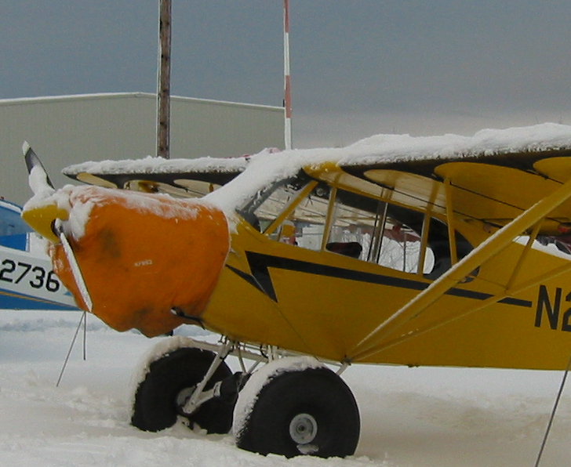
Winter Preflight
Ice, snow, & frost
Ice in controls, gear,
or prop spinner
Fuel drains
Fuel caps and vents
Exhaust system
Engine preheat
Notes:
You’ll need to make sure that the aircraft is ice, snow, and frost free of course. Be sure to check all control surfaces for freedom of movement. Sometimes water can freeze in control linkages, landing gear, and brakes – even in prop spinners.
If you can’t collect a fuel sample, it may mean that water in your fuel tank has frozen in and around the fuel drain. You’ll want to be sure that fuel is free to flow and that tank cap seals are serviceable, and vents are unobstructed.
Exhaust system integrity is essential any time of year but especially in winter when cabin heat is used. A carbon monoxide detector is a good investment in safety.
And you may need to preheat the engine before starting. Follow your engine manufacturers recommendations and, even if preheating is not required, allow plenty of time for the engine to come to operating temperature.
(Next Slide)

Slide 7
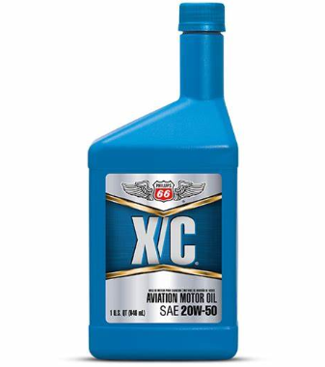
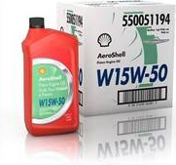
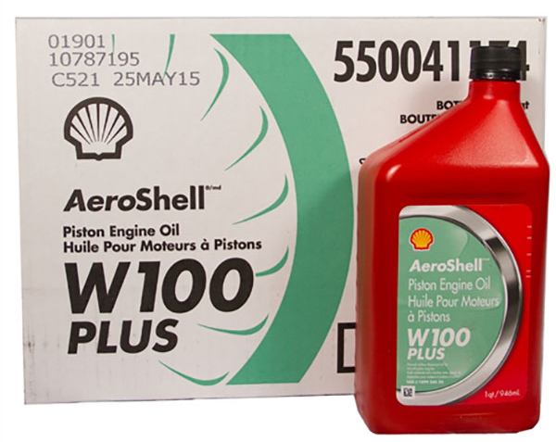
Oil viscosity
Notes:
Be sure to follow manufacturer’s guidance for aircraft oil. Multi-viscosity oils are formulated for a wide range of temperatures. Single viscosity oils should be appropriate for the operational environment temperature.
So, use the appropriate oil for environmental conditions, hangar or preheat your engine for easier starting, and allow extra time to reach operating temperature. Speaking of extra time. You’ll need more time to taxi on snow or worse, ice-covered, taxiways and runways.
(Next Slide)

Slide 8
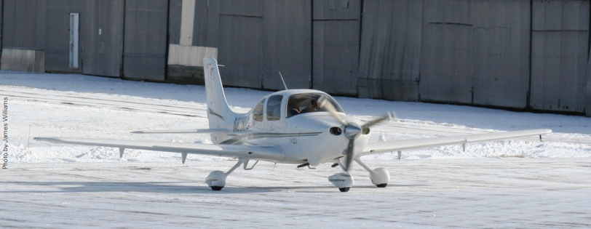
Winter taxiing
Notes:
Taxiing in winter can be exciting. Since your landing gear wheels aren’t driven, you’ll be able to go all right but, stopping and maneuvering in snow or on ice– especially in wind – can be challenging. The rule here is, take it slow – much slower than taxiing on uncontaminated surfaces. Plan turns and stops well in advance and be prepared for loss of traction. Once the flight controls are effective, winter takeoffs are straight forward but beware. Rejected takeoffs and landings on slippery surfaces can require a lot of runway.
(Next Slide)

Slide 9
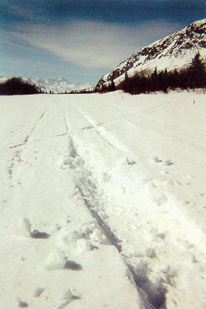
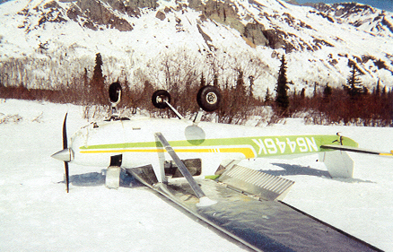
Good and bad news
Notes:
Although we should be prepared for off airport emergency landings on any flight there are some considerations and preparations that we should all be making when flying in winter. Here’s some good news. Forced landings in winter are statistically less likely to result in injuries or death. Soft snow can absorb energy and slow deceleration. (Click)
In this case, the snow was deeper than the pilot anticipated, and the aircraft ended up on its back. That’s the bad news. There’s no surefire way to judge snow depth from the air. A couple of inches of soft snow on the runway won’t be a problem but more than that could become expensive. As can be the case with any forced landing, you may not be able to use the airplane again – at least not right away. That means you’ll want to prepare to survive for a while in the most hostile environmental conditions expected along your route. Assuming you have no serious injuries, your first order of priority will be shelter and that begins with what you’re wearing.
(Next)

Slide 10
Shelter
What you’re wearing
  Layers and loft
  Insulated boots
  Mittens and gloves
  Beanies and Hoods
  Water-proof, breathable outer layer
Notes:
For best results, dress in layers. Wool is great but synthetics are good too. Insulation creates trapped layers of air that can slow body heat loss. Down is famously good for insulation – that is until it becomes wet. Synthetic fiber insulation is better when it’s soaked. (Click)
Insulated footwear is a must if you’re going to spend much time in the cold. Whether you’re sporting Army surplus bunny boots shown here or something from a reputable outfitter, keeping your feet warm and dry is a must. (Click)
Mittens are warmer and it’s easier to work in gloves. A pair of each is a good idea. Keep them in a parka pocket until needed. (Click)
A wool or synthetic fleece beanie is great for a base layer, but a hood is also a must have. It can be attached to your outer layer parka. (Click)
Pilots can choose from a wide variety of waterproof breathable outer layer garments. Snow pants fit over your base layer and a parka with plenty of
pockets completes the outfit.
(Next Slide)

Slide 11

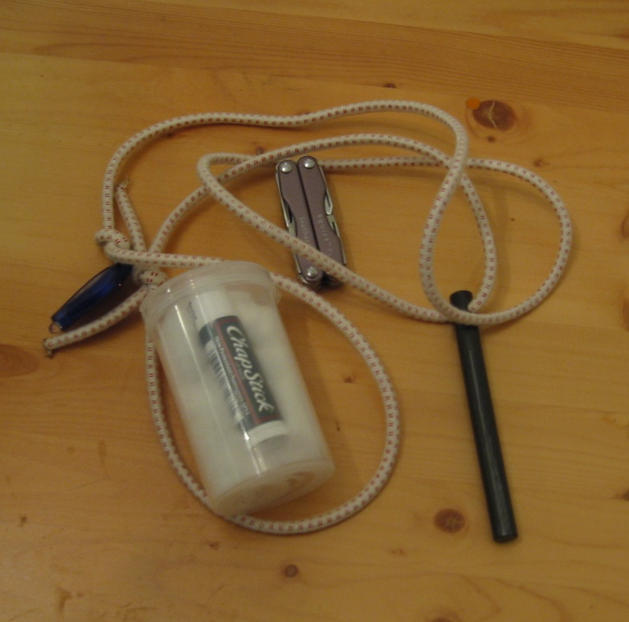
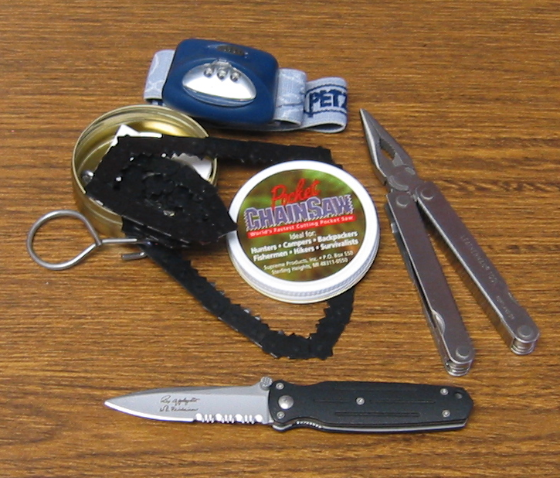

Survival gear
In your pockets
  Knife
  Multi-purpose tool
  Headlamp
  Compass
  Flint, striker & Kindling
Notes:
So why is it important to carry survival gear in your pockets?
Presentation note: Pause here for audience discussion of the question or proceed to answer it yourself.
There’s an old saying that suggests it’s reasonable to assume that, provided you’re un-injured, you’ll exit a downed aircraft with what you’re wearing and what’s in your pockets. Any other supplies may or may not be reachable. So, with that in mind, survival gear for your pockets should include a sturdy pocket or sheath knife and, or a multi-purpose tool with a knife blade. Include a headlamp, and a compass – stored in a separate pocket free of magnetic objects. In this picture we also see a compact chain saw that can be useful in preparing wood for a fire. (Click)
And speaking of fire, Here’s a compact incendiary essentials kit consisting of a flint and striker or waterproof matches and a waterproof container of kindling – in this case cotton balls - and a source of wax. Apply lip balm to a cotton ball and you have an excellent fire starter. (Click)
Most of us carry cell phones these days. They’re great for everyday communicating but not much use in remote areas. That’s why many pilots are carrying personal locater and communication devices. They’re relatively inexpensive and they’re an effective way to keep in touch from the boonies.
(Next Slide)

Slide 12
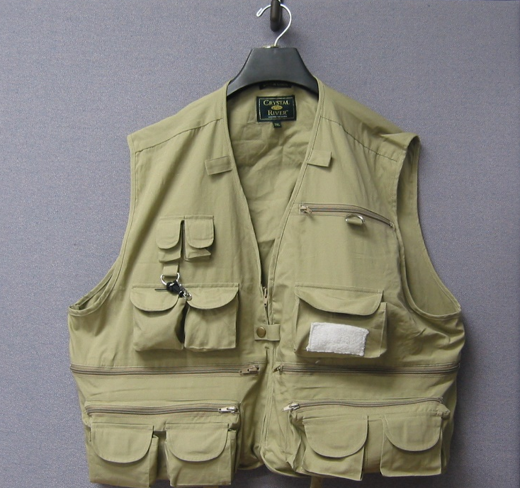
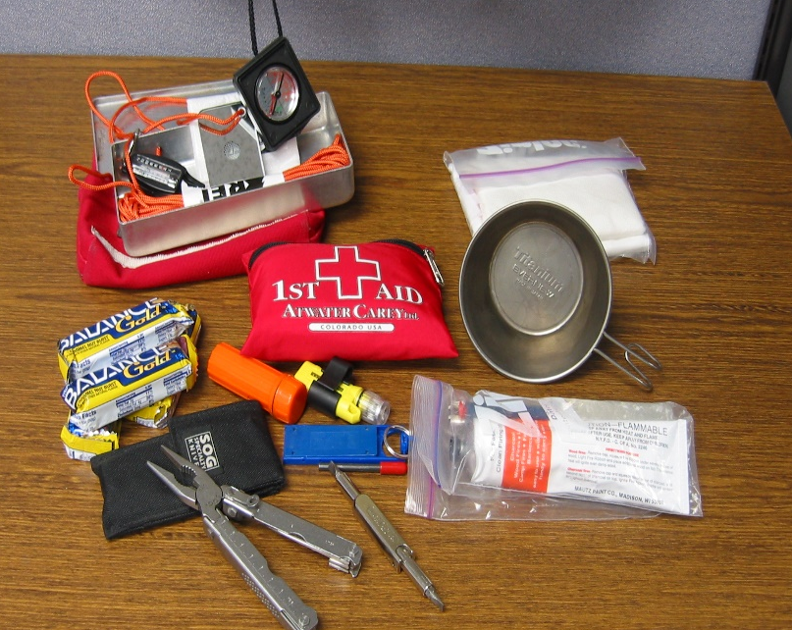
Gear
In a vest
  First Aid kit
  Rations
  Signaling devices
  Rain slicker
Notes:
It’s common for bush pilots to wear a survival vest while flying. A vest can store your survival gear in dedicated pockets. You can carry more than you can stuff in your pockets, and you don’t have to repack for each trip. Just replace what you use and things that have a shelf life such as batteries and food. (Click)
In this example we have the things we mentioned earlier plus a first aid kit, some survival rations, a couple of signaling devices, a rain slicker, titanium cup, and even some toilet tissue. The small pieces fit into an aluminum box that’s waterproof. Both the box and cup can be used for wilderness cooking.
(Next Slide)

Slide 13
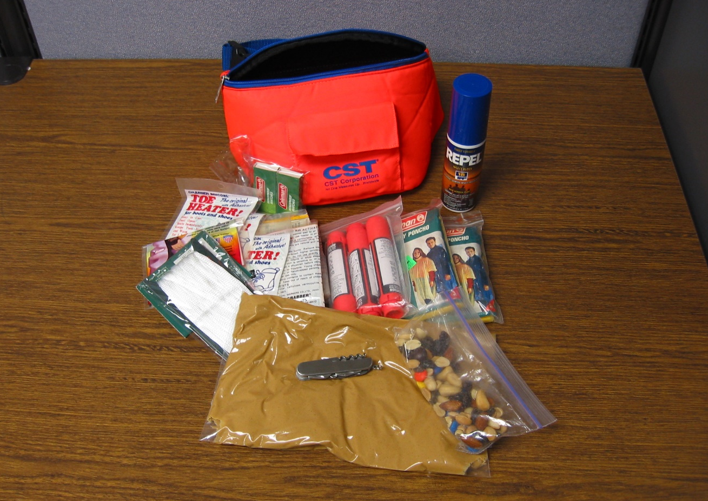
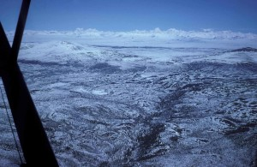
Gear
Notes:
One Alaskan aviator carries this fanny pack with even more survival gear. Note the gallon bag of peanut butter – an excellent survival food.
So, we’ve done a detailed preflight and we have our survival gear. Are we good to launch? Maybe so but first let’s talk about our route of flight.
(Next Slide)

Slide 14
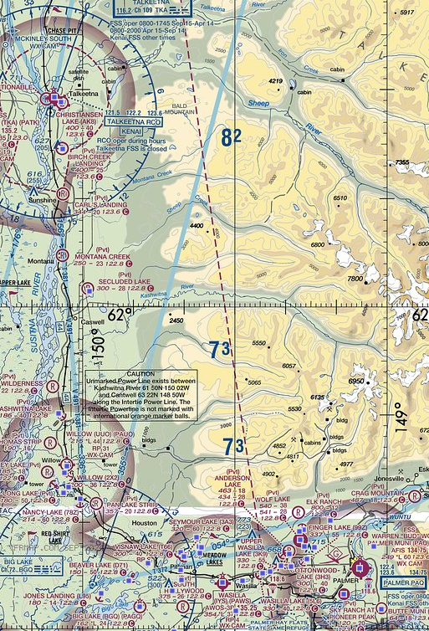

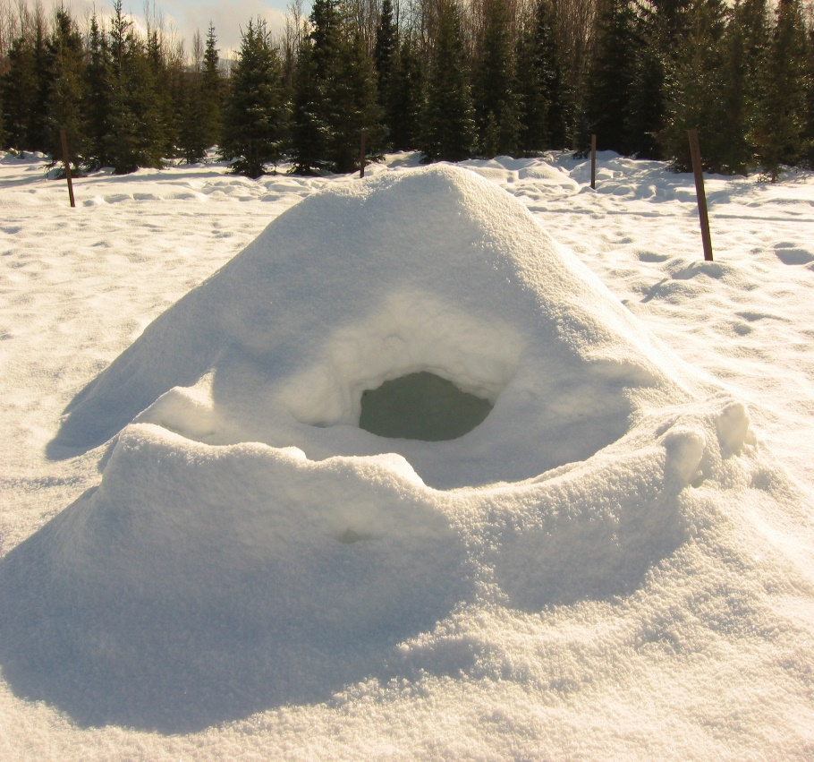
Flight route
Notes:
When it comes to winter flying, the direct route isn’t always best. (Click)
Following a highway or railroad may take a little longer but, if you have to land off airport, you’ll be closer to civilization and folks who can help. Winter days are short and unless you’re close to habitation, you’ll likely have to spend at least one night in the field. (Click)
Your route selection may well determine whether you spend the night in accommodations like this. (Click)
Or something more primitive that you build yourself like this snow cave. You can survive there but you will be far from comfortable. By the way – if temperatures are below freezing and especially if it’s windy, a snow cave is preferable to spending the night in your aircraft. You need lots of insulation and a small space for your body to heat. Perhaps it would be a good idea to pack a tent and some sleeping bags.
(Next Slide)

Slide 15
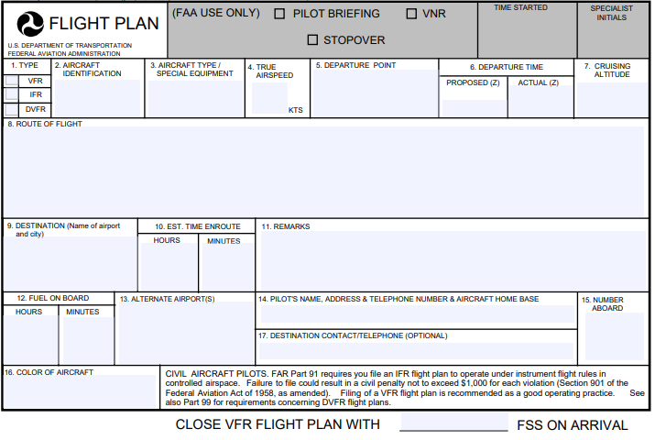
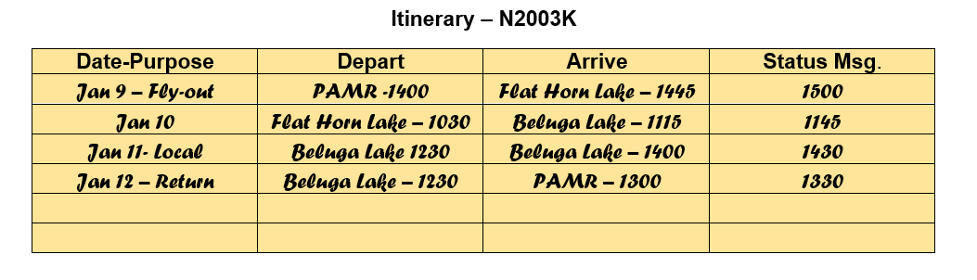
Flight Plan & Flight Following
Notes:
Obviously, you’ll want to file a flight plan for any flight and requesting flight following makes sense too. But especially if you’re going on a multi-day trip to areas where communication may be a challenge, you may also want to file an itinerary with a trusted agent before you leave. If you’re equipped with a Satellite Phone, or even a Satellite Messaging Device, you can transmit periodic status reports to your agent. A missing status report could trigger and target search and rescue efforts even if no flying was planned for the day.
(Next Slide)

Slide 16

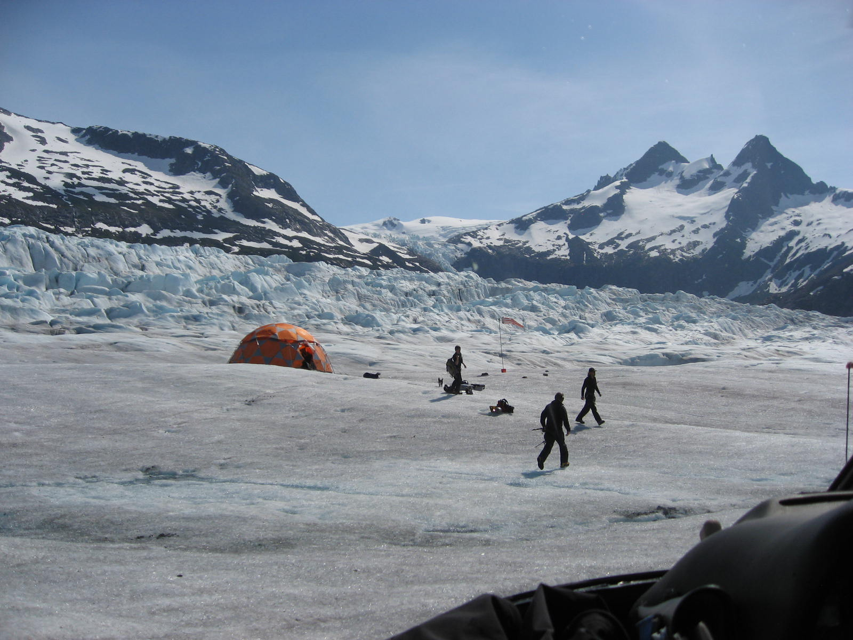
Camping gear
Notes:
You can survive quite comfortably in winter if you have the appropriate gear, and you know how to use it. That said, you’ll have to stow camping equipment in baggage compartments that may not be accessible if there’s a fire or the aircraft ends up in the water. That’s why we advise you to dress for the environment and have basic survival items on your person.
(Next Slide)

Slide 17



Stay put or hike out?
This Photo by Unknown Author is licensed under CC BY
This Photo by Unknown Author is licensed under CC BY-SA
Notes:
With proper knowledge, equipment, and most importantly, the will to survive; you can spend several winter days relatively comfortably in the field. If you’ve filed a flight plan and you’re on the filed route, folks will be looking for you and, if you’re camped near your aircraft, it will be easier for searchers to spot you. There are many arguments for staying put rather than hiking out. You’ll expend much more energy hiking through snow than you will sitting by a fire and, if you’re communicating with a trusted agent, rescuers are sure to be on their way.
(Next Slide)

Slide 18
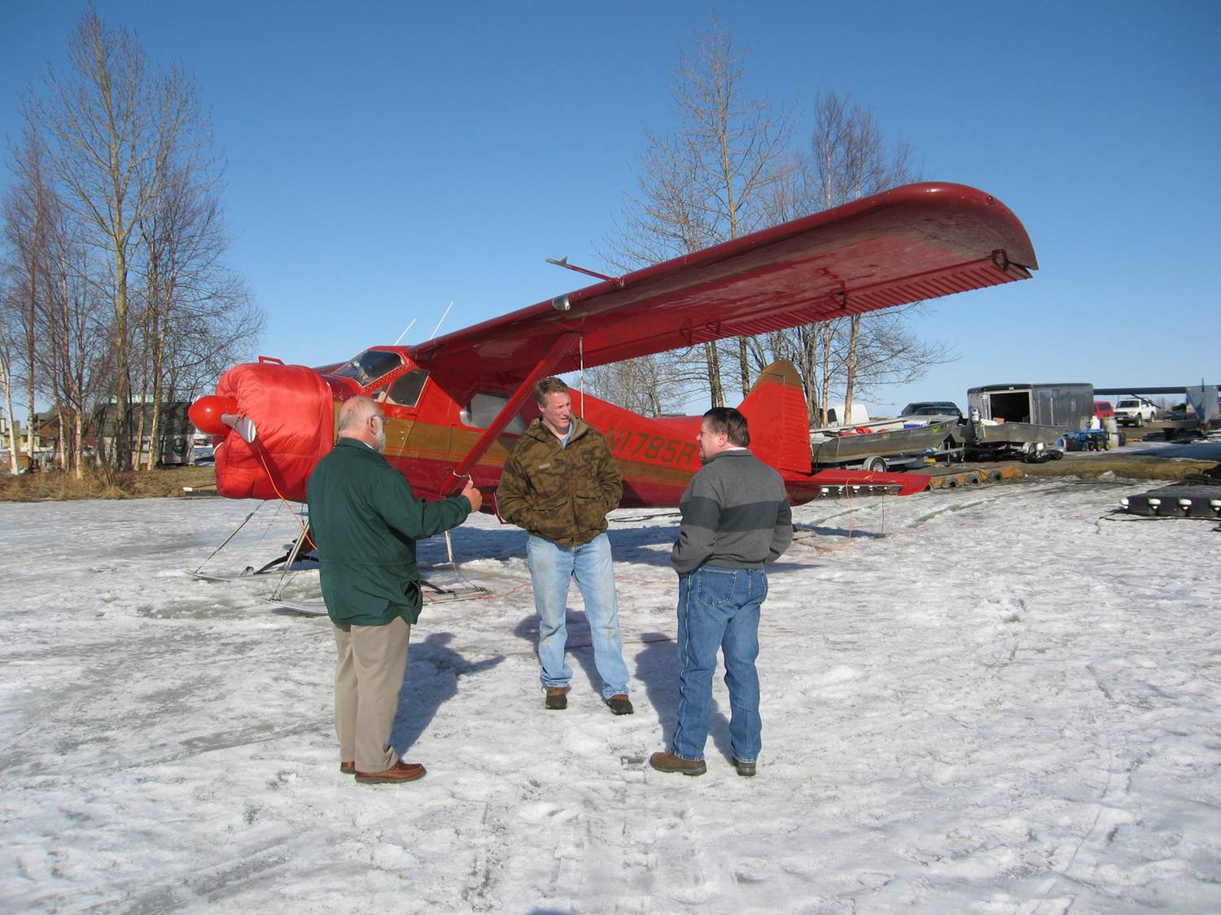
Formula for success
Preparation
Planning
Performance
Notes:
Success in any flying endeavor is ensured by proper preparation of pilot, passengers, and aircraft. Participation in a formal pilot proficiency program will enable you to fly at the top of your game and, just as importantly, help you to avoid situations that might require you to operate beyond your capabilities. Aircraft preparation includes mechanical condition of course but also maintenance and inspection intervals, weight and balance, and performance calculations. Likewise, passengers should be prepared for the flight environment and for survival in the environment over which you’re flying. (Click)
Planning optimal routes and participation in flight following are obvious best practices - also matching of destinations to aircraft and pilot performance capabilities. Leaving an itinerary with a trusted agent and periodic check in calls are also recommended. (Click)
Finally – performing within the plan parameters. That’s often expressed as, “plan the flight and fly the plan.” Good advice for most circumstances but pilots should constantly assess whether the flight is going to plan. If it isn’t, it’s essential to recognize that fact and immediately work to return to plan or pursue an alternate, safer course of action.
(Next Slide)

Slide 19

Begin your Human Factors journey here
http://bit.ly/HFcourses
Notes:
Human Factors knowledge is showing us how to excel in dealing with the physical, intellectual, and emotional challenges of flight. The benefits of Human Factors study are so great that we’ve developed a series of online Human Factors for Pilots courses. We encourage you to explore the series. Navigate to the URL or scan the QR code on screen for a FAASTeam Human Factors course catalog that features direct links to each of the courses.
(Next Slide)

Slide 20
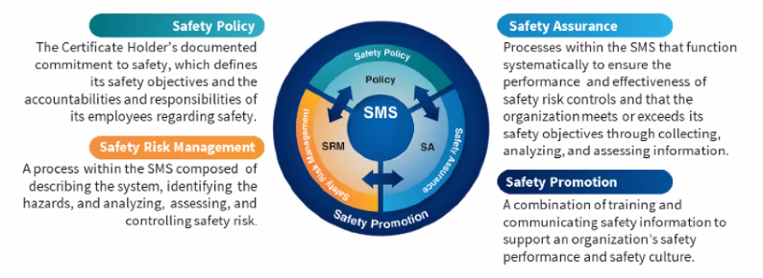

Safety Management Systems (SMS)
Coming to General Aviation
Safety Management System (SMS) | Federal Aviation Administration (faa.gov)
Notes:
Safety Management Systems are a set of policies and processes that can increase the safety and efficiency of any flight operation. And FAA is bringing SMS to General Aviation. You may have heard of SMS but thought it was only for large organizations but actually, SMS can be scaled to fit any operation large or small.
There are 4 major components to a Safety Management System (Click)
Safety Policy – a documented commitment to safety that runs from the head of an organization to its newest member. (Click)
Safety Risk Management – a process that identifies hazards within an operation, determines to what extent an identified hazard may impact flight safety, and controls the risk of occurrence to an acceptable level. (Click)
Safety Assurance – By collecting and analyzing information derived from safety performance data Safety Assurance ensures the performance and effectiveness of Safety Risk Controls. (Click)
Safety Promotion communicates safety information and commitment throughout the organization. (Click)
You can find more information about Safety Management Systems at the URL on the Screen.
(Next Slide)

Slide 21

Questions?
Notes:
Presentation Instruction: You may wish to provide your contact information and main FSDO phone number here. Modify with
Your information or leave blank.
(Next Slide)

Slide 22
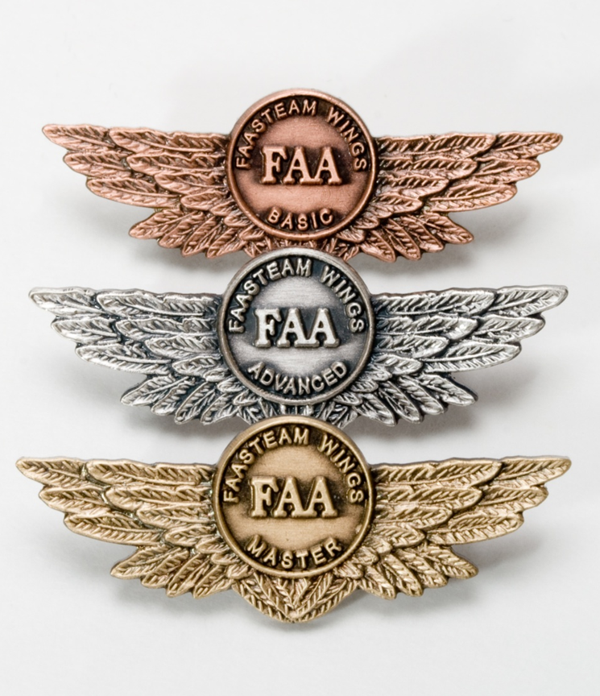
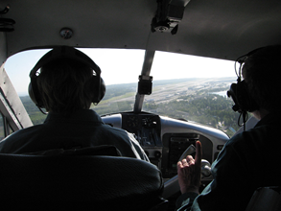
Proficiency and Peace of Mind
Fly regularly with your CFI
Perfect Practice
Document in WINGS
Notes:
There’s nothing like the feeling you get when you know you’re playing your A game and in order to do that you need a good coach (Click)
So, fly regularly with a CFI who will challenge you to review what you know, explore new horizons, and to always do your best. Of course you’ll
have to dedicate time and money to your proficiency program but it’s well worth it for the peace of mind that comes with confidence. (Click)
Vince Lombardi, the famous football coach said, “Practice does not make perfect. Only perfect practice makes perfect.” For pilots that means
flying with precision. On course, on altitude, on speed all the time. (Click)
And be sure to document your achievement in the Wings Proficiency Program. It’s a great way to stay on top of your game and keep you flight review current.
(Next Slide)

Slide 23
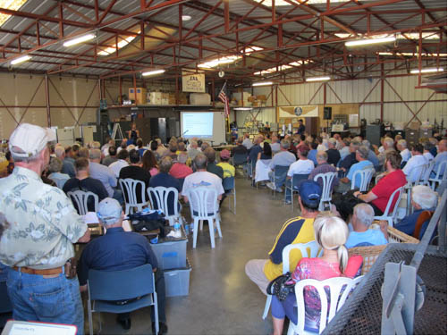
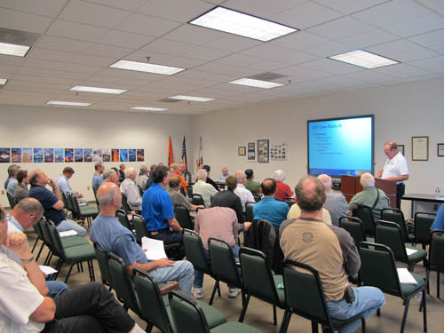
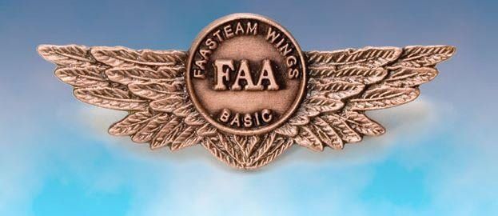
Thank you for attending
You are vital members of our GA safety community
2024/09-10-316(I)PP
Notes:
Your presence here shows that you are vital members of our General Aviation Safety Community. The high standards you keep and the examples you set are a great credit to you and to GA.
Thank you for attending.
(Next Slide)

Slide 24
The National FAA Safety Team Presents
Tips for Winter Flight Operations
<Audience>
<Presenter>
< >
Notes:
(The End)

